Slide 1
NETS Ingenico Desk5000 TERMINAL LINKPOINTS User Guide – Merchant
Presented by: NTUC LINK NETS TERMINAL TRAINING TEAM

Slide 2
Rates for Awarding and Redemption of LinkPoints
Eg. MERCHANT: 0.5% (BASE)
Awarding of LINKPOINTS (Different for each Merchants) Merchant Pay to NTUC Link for each LINKPOINTS Awarded to Users | Every $2 spent = 1 LINKPOINTS
Redemption of LINKPOINTS (Same for All Merchants) NTUC Link Pay to Merchant for the amount redeemed from user’s LINKPOINTS Account | 100 LINKPOINTS = $1 Cash Value
NOTES
LINKPOINTS to be awarded to users based on Gross Purchase Price
(Amount Customer is to Pay)
1. E.G: Gross Purchase Price is $100/-
2. If Member has $10 worth of LINKPOINTS and wish to Offset $10 from the Gross Purchase Price $100, Cashier to do <Redemption by Amount> on Terminal
3. Ideal for Merchant POS to have payment button for LINKPOINTS Redemption so that Cashier can key in the $10 amount offset by LINKPOINTS and POS will prompt Cashier to collect Balance Payment Amount of $90 from user
- LINKPOINTS awarded to user based on Gross Purchase Price of $100
- User Pay Balance amount of $90 and NTUC Link pay to Merchant $10

Slide 3
兑换颁发LinkPoints比率
例. 贸易商: 0.5% (基础)
颁发 LINKPOINTS (每个商家都不同) 贸易商发 LinkPoints, 须要付 NTUC Link | 每消费 $2 = 1 LINKPOINTS
兑换 LINKPOINTS (每个商家都一样) 商家接受客户兑换LinkPoints, NTUC Link须要付款给贸易商 | 100 LINKPOINTS = $1 现款
注意
商家颁发LINKPOINTS给客户 来自他们的总购买价款
(客户需要支付的金额)
1. 例.总购买价款是 $100/-
2. 假如会员只有 $10 LINKPOINTS定值 并想要从总购买价款$100 扣除$10, 收银员该在刷卡器上使用 <Redemption by Amount> (按金额赎回)
3. 适用于商家POS设有LINKPOINTS兑换付款按钮，这样收银员可以输入由LINKPOINTS的$10，这将促使收银员从会员处收取$90余额支付金额
- LINKPOINTS 以$100 的总购买价格授予用户
- 会员支付余额$90, NTUC Link支付给商家$10

Slide 4
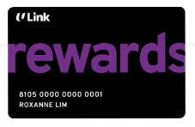
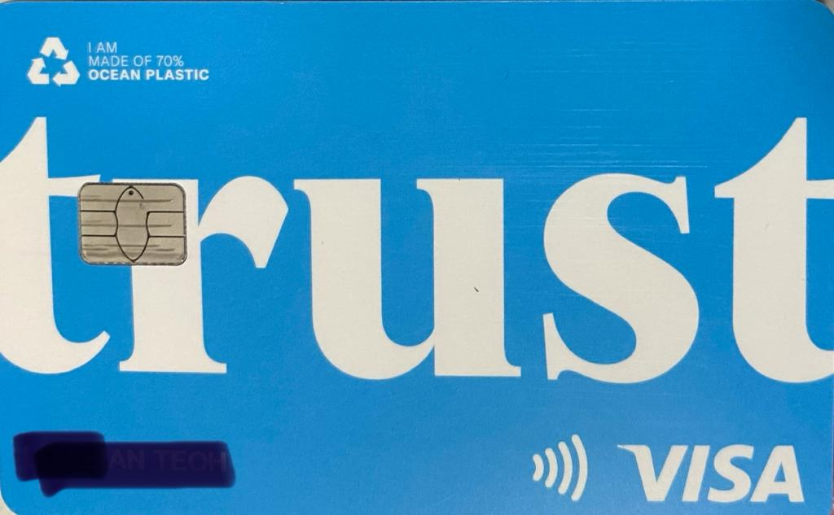
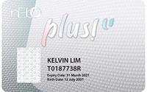
How Ingenico deck5000 Terminal Read the Ulink Card
Swipe on Terminal
(Non-Credit Card)
Insert into Terminal
(Credit Card)
Non
Union Trust CreditCard
Union Trust CreditCard

Slide 5
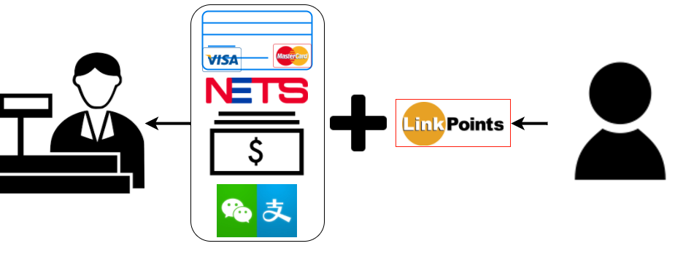
Cashier Flow (POS with LinkPoints Button)
Cashier ask customer for Plus! Card
Cashier proceed to award or award/redeem LINKPOINTS for customer
After LINKPOINTS award or award/redeem is complete, Cashier to key into POS the amount($) for redemption by LINKPOINTS (if any)
Cashier to collect the Balance Payment from customer

Slide 6
付款程序 (带有LinkPoints按钮的POS)
收银员向会员询问有无Plus！卡
收银员继续为会员颁发/兑换LINKPOINTS
在LINKPOINTS颁发/兑换完成后，收银员将LINKPOINTS兑换的金额（$）输入POS（如果有的话）
收银员从会员处收取余额付款

Slide 7
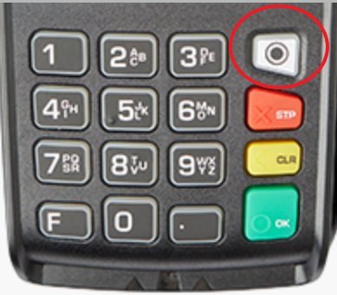
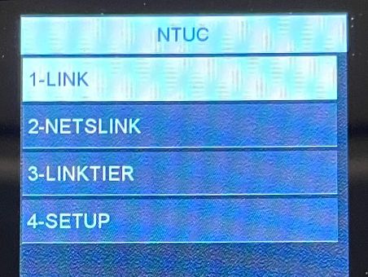
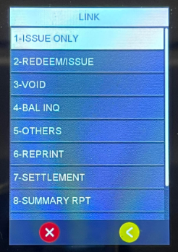
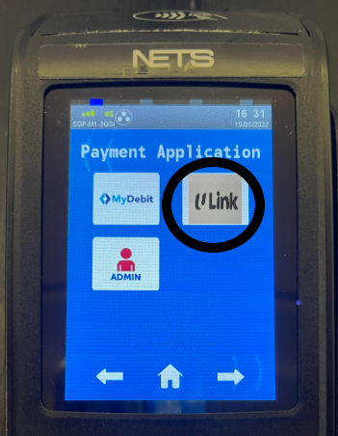
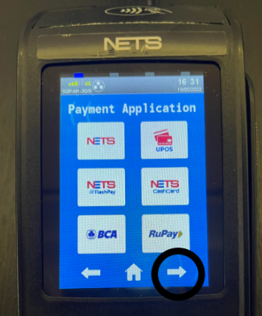
LINKPOINTS toggling on Ingenico Desk5000Terminal
How to Go to LINKPOINTS Software
Step 1. At NETS KeyPad press white button
Step 2. On screen press right Arrow for next page
Step 3. Press ‘ULink’
Step 4. Press ‘1 - LINK’

Slide 8
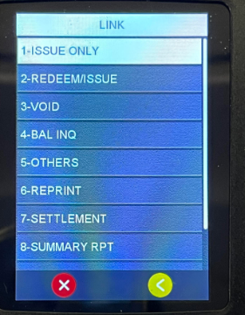
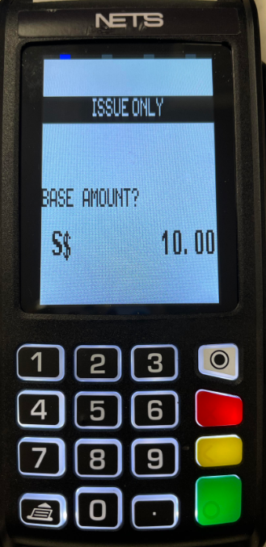
Issue LinkPoints only
Step 1. At NETS KeyPad Press white button Step 2. On screen press right Arrow for next page Step 3. Press ‘ULink’ Step 4. Press ‘1 - LINK’ Step 5. Press ‘ISSUE ONLY’ Step 6. Swipe/insert/tap member’s card Step 7. Key in the purchase amount and press green button to enter. op 9
Step 5
Step 7

Slide 9
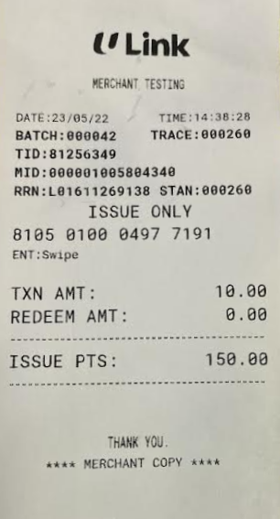
Issue Only LinkPoints receipt
Based on Receipts Shown,
SCHEME: $2 = 1 LinkPoints
Transaction Amount: $10
ISSUE LINKPOINTS: 5 LINKPOINTS
5.00

Slide 10
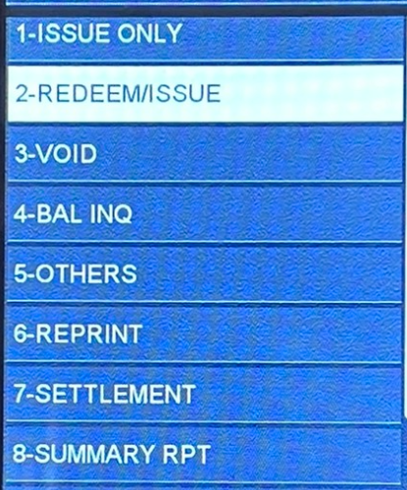
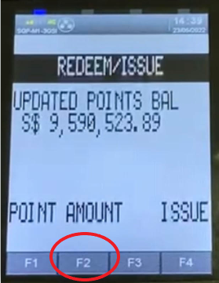
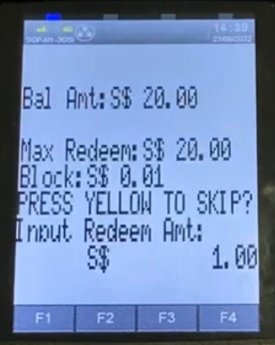
Redeem/Issue LinkPoints
Step 5
Step 1. At NETS KeyPad Press white button Step 2. On screen press right Arrow for next page Step 3. Press ‘ULink’ Step 4. Press ‘1 - LINK’ Step 5. Press ‘REDEEM/ISSUE’ Step 6. Swipe/insert/tap member’s card Step 7. Key in the purchase amount and press green button to enter. (Screen show LinkPoints balance in card) Step 8. Press screen ‘F2’ AMOUNT Step 9. Input the redeem $ amount and press green button to enter.
Step 8
Step 9

Slide 11
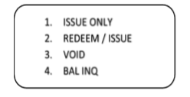
User wants to Earn and Redeem LINKPOINTS
会员想赚取与兑换
ISSUE ONLY
REDEEM / ISSUE
VOID
BAL INQ
Step 1.Press F button on keypad 步骤 1.在键盘上 按 F 转到 PLUS主页面 Step 2. Press 3 for “Plus!” 步骤 2.在屏幕上 按 3 选择 “Plus!” 2a) Press 1 for “Link” Step 3.Press 2 for “REDEEM/ISSUE” 步骤 3.按 2 选择 “REDEEM/ISSUE” (兑换/颁发) Step 4. INSERT/SWIPE CARD 步骤 4.屏幕显示 INSERT/SWIPE 并进行刷卡 Step 5.Key in Purchase amount then Press ENTER 步骤 5.输入 购买金额 ,按绿键 Step 6. Press Amount Key for YES (screen show balance in card) 步骤 6. 按 Amount 键 (屏幕可见使用以$和¢显示Plus!卡里的余额) Step 7. Select Amount 步骤 7.按 兑换金额 Step 8. Key in Redeem Amount($) that user wants to redeem and ENTER 步骤 8.输入 兑换金额 ,按 ENTER(绿键)
STEP 7
REDEEM / ISSUE
UPDATED POINTS BAL
$ 19,743.11
REDEEM YES OR NO
GREEN KEY 🡪 YES
YELLOW 🡪 NO
STEP 8
BAL AMT: $ 2.00
MAX REDEEM: $ 2.00
BLOCK: $ 0.01
PRESS YELLOW TO SKIP?
INPUT REDEEM AMT:
$ 1.00

Slide 12
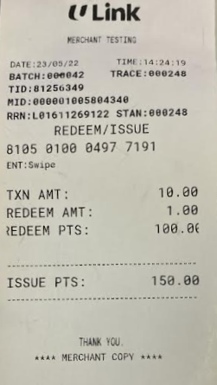
LINKPOINTS Award and Redeem Receipt
Based on Receipts Shown,
SCHEME: $2 = 1 LinkPoints
Transaction Amount: $10
ISSUE LINKPOINTS: 5.00 LINKPOINTS
REDEMPTION OF LINKPOINTS: $1 (100 LPS)
Balance Amount to collect from member: $9 = $10 - $1
Transaction Amount: $10
Member pay to Merchant: $9
NTUC Link pay to Merchant: $1
Total Amount Merchant receive: $10
5.00

Slide 13
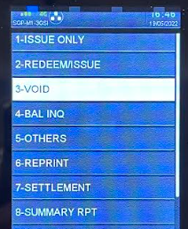
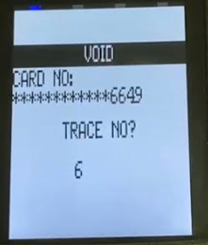
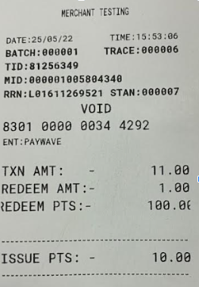
LINKPOINTS VOID
Scenario
Cashier already completed LINKPOINTS Transactions and
- Cashier makes a mistake for the LINKPOINTS (key wrong amount)
- Customer decides to cancel purchase / add more items
Cashier need to VOID LINKPOINTS Transactions and re-do LINKPOINTS (if required)
Step 1. At NETS KeyPad Press white button Step 2. On screen press right Arrow for next page Step 3. Press ‘ULink’ Step 4. Press ‘1 - LINK’ Step 5. Press ‘VOID’ Step 6. Swipe/insert/tap member’s card Step 7. Enter TRACE number (Trace number can be found on the receipt) Step 8. Press green button to enter
5.50
NOTE
Void can only be done when member’s card is still present and before Settlement
Otherwise, need to submit via Manual Transaction Adjustment Form (MTA)
*Input TRACE NO without the zeros at the front

Slide 14
LINKPOINTS 取消
情形
收银员已经完成LINKPOINTS交易和
收银员对LINKPOINTS犯了一个错误 (因输入错的金额)
会员想取消交易 / 添加更多购买
收银员该取消 LINKPOINTS交易 并重做LINKPOINTS (如果需要)
在键盘上 按 F 转到主页面 在屏幕上 按 3 “Plus!” 2a-在屏幕上 按 1 “LINK” 选 3 “VOID” (取消) 屏幕显示INSERT/SWIPE 并进行刷卡 输入TRACE NO (2)「输入交易编号 6 按 ENTER(绿键)
STEP 6
5.50
注意
只有当会员卡仍然在场和进行 Settlement之前, 才能进行取消交易
否则，需要通过提交 Manual Transaction Adjustment Form (MTA)

Slide 15
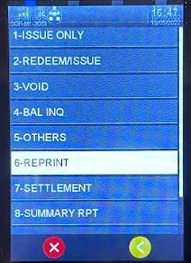
LINKPOINTS REPRINT
Scenario
- Terminal runs out of paper while printing
- Lost of LinkPoints receipts
Step 1. At NETS KeyPad Press white button Step 2. On screen press right Arrow for next page Step 3. Press ‘ULink’ Step 4. Press 1 - LINK Step 5. Press ‘Reprint’ Select based on Choice LAST RECEIPT ANY RECEIPT (Input TRACE NO) LAST SETTLEMENT RECEIPT

Slide 16
收据 重印
情形
打印结算途中没纸
收据遗失
在键盘上 按 F 转到主页面 在屏幕上按 3 选择 “Plus!” 2a -在屏幕上按 1 选择 “LINK” 选 6 选择 “REPRINT” （重印） 根据需求进行选择 LAST RECEIPT （最后一张收据） 2) ANY RECEIPT (Input TRACE NO) 特定交易收据 「输入 交易编号」 3) LAST SETTLEMENT RCPT （最后结账收据 )
STEP 5
LAST RECEIPT
ANY RECEIPT
LAST SETTLEMENT RCPT

Slide 17
LINKPOINTS DETAIL REPORT (Optional)
Scenario
To get the following information for checking
(Card Number, Txn Amt, Transaction Type, Trace No, Summary Rpt)
情形
这报告可用来进行检查（卡号，交易金额，交易类型，交易编号，汇总报告）
Press F Press 3 for “Plus!” 2a ) press 1 for “LINK” Press 9 for “DETAIL RPT”
在键盘上按 F 转到主页面 在屏幕上按 3 选择 “Plus!” 选 9 选择 “DETAIL REPORT” （详细报告）
STEP 4
6. REPRINT
7. SETTLEMENT
8. SUMMARY REPORT
9. DETAIL REPORT

Slide 18
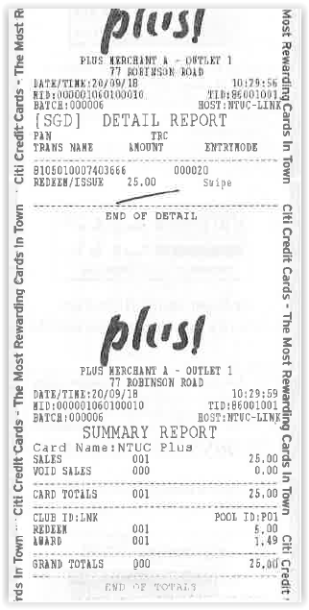

Slide 19
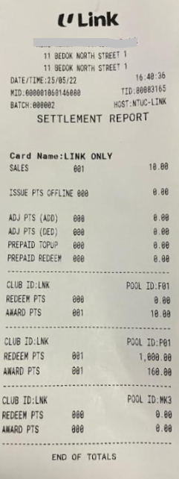
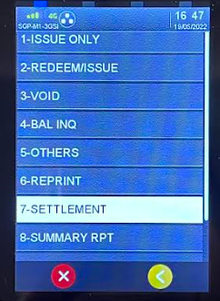
LINKPOINTS SETTLEMENT
Scenario
Cashier to do settlement end of day to get the summary of total transaction amount and LINKPOINTS
Step 1. At NETS KeyPad Press white button
Step 2. On screen press right Arrow for next page
Step 3. Press ‘ULink’
Step 4. Press 1 - LINK
Step 5. Press ‘Settlement’
NOTE
In the event that while printing of SETTLEMENT and terminal runs out of paper, do REPRINT of SETTLEMENT (Refer to LINKPOINTS REPRINT guide)
DO NOT PRESS ON SETTLEMENT BUTTON AMOUNT AGAIN AS IT WILL PRINT OUT ZERO TRANSACTION SETTLEMENT RECEIPTS

Slide 20
SETTLEMENT REPORT (To be done daily)
Total Trnx Count: 1
Total Points Issued = 160 LinkPoints
Total Redeem Points = 1000 LinkPoints ($10)
(should be tally with Total POS LINKPOINTS redeem amount($))

Slide 21
LINKPOINTS FAQ FOR TRAINING
Minimum Purchase Amount to earn LINKPOINTS: $1
Maximum Purchase Amount to earn LINKPOINTS: $10,000/- (if exceed please split into 2 purchase.)
Terminal will prompt “Decline 13: Exceed Cap Amount” if purchase exceed $10,000/-
If Inactive card, Terminal will prompt “Decline 58: Invalid Trnx”
If Block card , Terminal will prompt “Decline 05: DO Not Honor”
System busy , Terminal will prompt “Host not Responding”
Perform LINKPOINTS settlement at the END of the day before NETS settlement.
If while doing LINKPOINTS Transactions and Terminal hang, plug out and plug back power cable
Customer’s Plus card got Problem
Inform Customer to call NTUC Link Customer Service Hotline: 6380 5858
OR the hotline number behind their card.
Hardware Problem
Call NETS Terminal Service Centre: 6274 1212
LINKPOINTS Transaction or Software Problem
🡪 Call NTUC Link Merchant Support Hotline :8268 4889
Or Email to : link-sd@NTUCLINK.COM.SG (Subject: Merchant enquiries)

Slide 22
END OF TRAINING FOR LINKPOINTS

